Slide 1
Network and Cyber Security-I (CY2001) (Lecture 4)
Dr. Qaisar Shafi
Department of Computer Science,
National University of Computer & Emerging Sciences, Islamabad Campus

Slide 2
Extending “CIA” and Symmetric Ciphers

Slide 3
Examples of Security Requirements:
Confidentiality:
High | Medium | Low
Student Grade | Student enrollment information | Directory information
Integrity:
High | Medium | Low
patient’s allergy information | online newsgroup registration data | anonymous online poll
Availability
High | Medium | Low
authentication system | public website for university | online telephone directory lookup
Notes:
A hospital patient’s allergy information (high integrity data): a doctor should be able to trust that the info is correct and current
If a nurse deliberately falsifies the data, the database should be restored to a trusted basis and the falsified information traced back to the person who did it
An online newsgroup registration data: moderate level of integrity
An example of low integrity requirement: anonymous online poll (inaccuracy is well understood)
A system that provides authentication: high availability requirement
If customers cannot access resources, the loss of services could result in financial loss
A public website for a university
a moderate availably requirement; not critical but causes embarrassment
An online telephone directory lookup
a low availability requirement because unavailability is mostly annoyance (there are alternative sources)

Slide 4
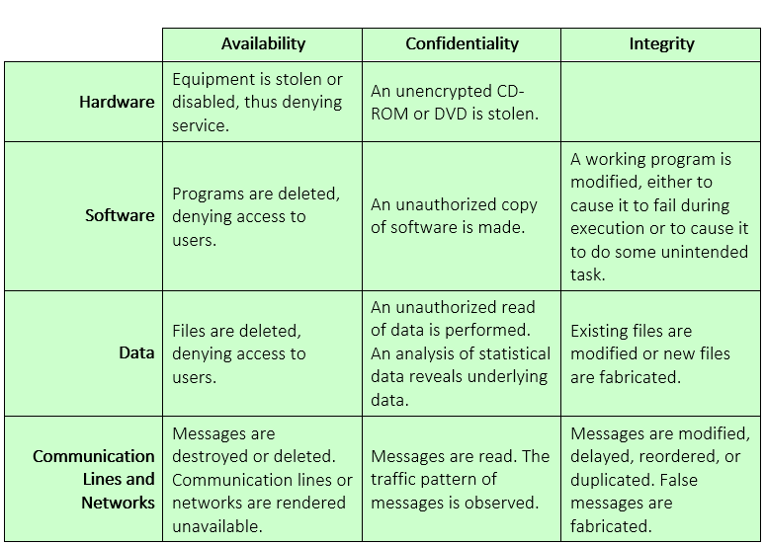
Activity

Slide 5
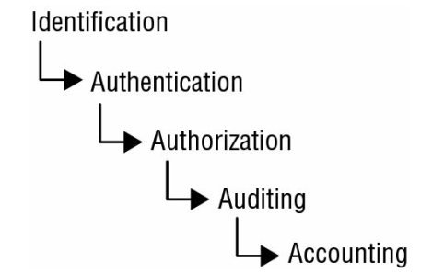



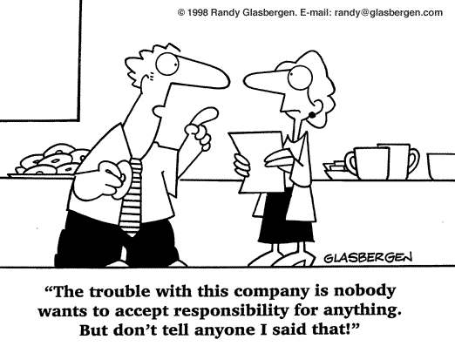
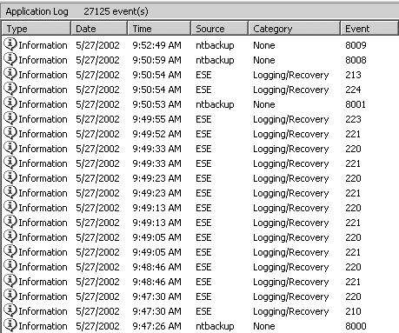
Beyond CIA: Access Control
Notes:
Confidentiality, integrity, and availability are only the beginning of the information security story. Beginning at the beginning, consider the situation when customer Bob logs on to his computer. How does Bob's computer determine that "Bob" is really Bob and not Trudy? And when Bob logs into his account at Alice's Online Bank, how does AOB know that "Bob" is really Bob, and not Trudy? Although these two authentication problems appear to be similar on the surface, under the covers they are actually completely different. Authentication on a standalone computer typically requires that Bob’s password be verified. To do so securely, some clever techniques from the field of cryptography are required. On the other hand, authentication over a network is open to many kinds of attacks that are not usually relevant on a standalone computer. Potentially, the messages sent over a network can be viewed by Trudy. To make matters worse, Trudy might be able to intercept messages, alter messages, and insert messages of her own making. If so, Trudy can simply replay Bob's old messages in an effort to, say, convince AOB that she is really Bob. Since information security people are professional paranoids, we always assume the worst. In any case, authentication over a network requires careful attention to protocol, that is, the composition and ordering of the exchanged messages. Cryptography also has an important role to play in security protocols. Once Bob has been authenticated by Alice's Bank, then Alice must enforce restrictions on Bob's actions. For example, Bob can't look at Charlie’s account balance or install new accounting software on the AOB system. However, Sam, the AOB system administrator, can install new accounting software. Enforcing such restrictions goes by the name of authorization. Note that authorization places restrictions on the actions of authenticated users. Since authentication and authorization both deal with issues of access to resources, we'll lump them together under the clever title of access control.
Identification
Identification is the ability to identify uniquely a user of a system or an application that is running in the system
A subject must provide an identity to a system to start the process of authentication, authorization, and accountability (AAA).
Providing an identity can involve typing in a username; swiping a smart card;
Authentication
The process of verifying or testing that the claimed identity is valid is authentication
Authentication requires from the subject additional information that must exactly correspond to the identity indicated.
This includes the password variations of PINs and passphrases
Authorization
Grant ability to access information (After a person has provided authentication she may have the authority to access the credit card number or enter a room that contains the web server, provided the person has been given prior authorization)
Auditing
Recording a log of the events and activities related to the system and subjects.
Auditing, or monitoring, is the programmatic means by which a subject’s actions are tracked and recorded for the purpose of holding the subject accountable for their actions while authenticated on a system.
Accounting (aka accountability) reviewing log files to check for compliance and violations in order to hold subjects accountable for their actions.
Nonrepudiation ensures that the subject of an activity or event cannot deny that the event occurred.
Nonrepudiation is an essential part of accountability
Nonrepudiation prevents a subject from claiming not to have sent a message, not to have performed an action, or not to have been the cause of an event.
It is made possible through identification, authentication, authorization, accountability, and auditing.
Authenticity: the property of being genuine and being able to be verified and trusted; confident in the validity of a transmission, or a message, or its originator
Accountability: generates the requirement for actions of an entity to be traced uniquely to that individual to support nonrepudiation, deference, fault isolation, forensics etc

Slide 6
AAA
Framework to control access to resources
Authentication
Authorization
Accounting
More Terminologies
Identification
Auditing
Access control

Slide 7
Authentication
Process of identifying user
Confirm right person is accessing system
Who is allowed to access
Claim to be someone is know as identification(by providing Login/ password)
When you prove it, you are authenticated
Know, have, are?
Password, MFA, certificate

Slide 8
Authorization
Granting correct level of access based on credentials
Access control are methods to enforce authorization policies
Right people should have right access level
Principle of least privileges on users, devices programs and processes
Violation can result in CIA breaches?

Slide 9
Access control
Access control is a data security process that enables organizations to manage who is authorized to access corporate data and resources. Secure access control uses policies that verify users are who they claim to be and ensures appropriate control access levels are granted to users.
Access control are method to enforce authorization policies
RBAC

Slide 10
Accounting
Keep track of activities
Monitor activities for security and compliance
What files are accessed , who accessed them, what modification is done
Particular user have access to system at this date and time ….
In case of cyber incident PROOF is available and valuable to investigate.

Slide 11
Auditing
As accounting is maintaining records and auditing is evaluating them in case of cyber incident
Vulnerability assessment
Penetration testing
Compliance auditing
Forensics auditing

Slide 12
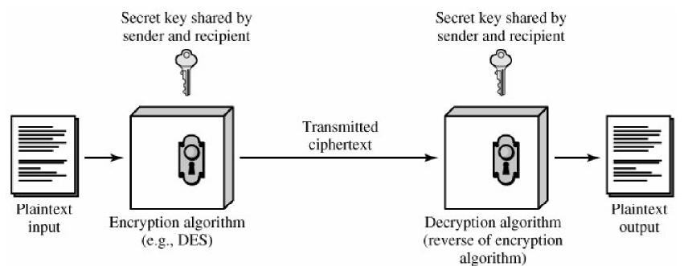
Symmetric Cipher Model

Slide 13
Requirements for secure use of encryption
Need a strong encryption algo.
Algo should be such that the opponent who knows the algo and has access to one or more cipher-text, would unable to decipher or discover the key.
Sender and receiver must exchange the key in the secure manner.

Slide 14
Continues…
It is impractical to decrypt a message on the bases of cipher test + knowledge of the algo.
Algo do not need to be secret, need to keep only key secret.
Wide use of symmetric ciphers ….

Slide 15
Model of Conventional Cryptosystem
Source produces message in plaintext X=[X1,X2,X3…..XM].
Key K=[K1,K2,K3…..KJ].
If the key generated at the source , must also be provided to the destination.
Alternatively , a third party can provide.
Y=E(K,X)

Slide 16
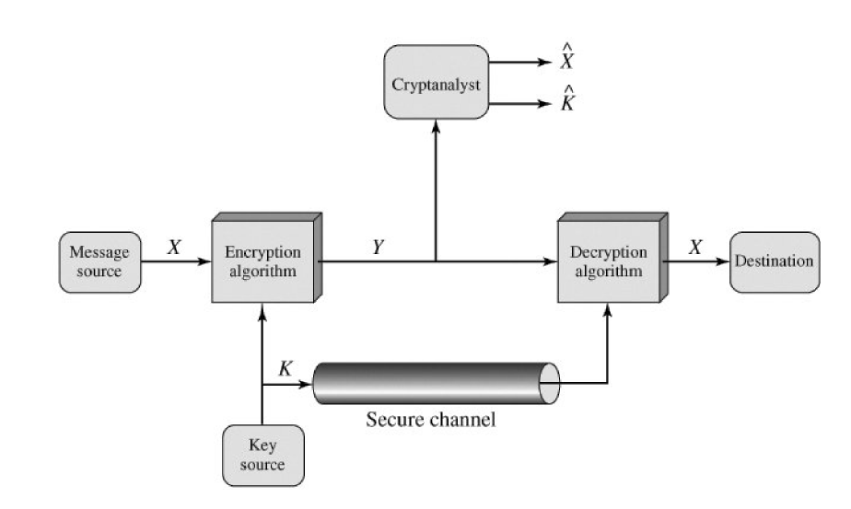
Model of Conventional Cryptosystem

Slide 17
Cryptosystem three independent Dimensions
Type of operations used for transforming plaintext to ciphertext.
Substitution
Transposition
Product system
Fundamental requirement (no information is lost, all operations should be reversible)
The number of keys used.
The way in which plaintext is processed.
Block ciphers
Stream ciphers

Slide 18
Cryptanalysis
Attacking ciphers
Two approaches for attacking
Cryptanalysis
Try to exploit the characteristics of the algo
Brute-force attack
Try all options

Slide 19
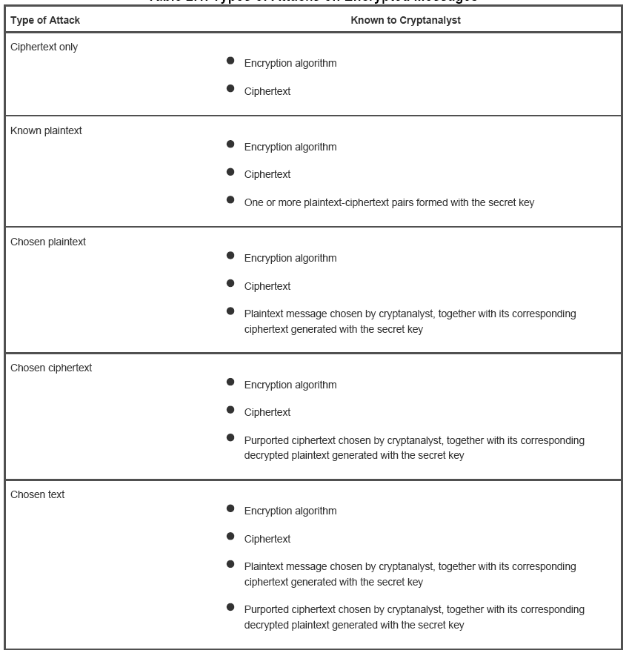

Slide 20
Substitution techniques
A substitution technique is one in which the letters of plaintext are replaced by other letters or by numbers or symbols.

Slide 21
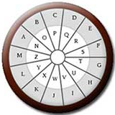
ROT-13 cipher
The ROT-13 cipher was commonly used to hide the meaning of messages on the Internet (particularly on Usenet and E-mail).
Each letter in the plaintext is substituted with the ciphertext letter according to the following mapping:
p : ABCDEFGHIJKLMNOPQRSTUVWXYZ
F(p) : NOPQRSTUVWXYZABCDEFGHIJKLM
Example:
Plaintext: THIS IS A SECRET
Ciphertext: GUVF VF N FRPERG
The ROT-13 cipher is an involution (i.e., self-inverse) so that encoding twice will result in the original message.
This means that a separate decoding function F^{–1} is not needed.

Slide 22
Caesar cipher
The Roman emperor Julius Caesar used to substitute each letter in his diplomatic communications with the letter that was three letters further along in the alphabet.
p : ABCDEFGHIJKLMNOPQRSTUVWXYZ
F(p) : DEFGHIJKLMNOPQRSTUVWXYZABC
Plaintext: ET TU BRUTUS
Ciphertext: HW WX EUXWXV
Notes:
French: ET TU BRUTUS English: AND YOU BRUTUS

Slide 23
Caesar cipher
The cipher used by Julius Caesar can be generalized to a function defined by a parameter k representing the number of letters that we “shift” each plaintext letter: c = F_{k}(p) = p + k (mod 26)
Where Julius Caesar used k=3, and ROT-13 uses k=13.
This cipher is called the Caesar cipher.
The parameter k is called the key.
Example: YVCCF Z YFGV PFL WZEU KYZJ ZEKVIVJKZEX
Notes:
HELLO I HOPE YOU FIND THIS INTERESTING
Enc Key = 17
Dec Key = 9

Slide 24
Cracking the Caesar cipher
Caesar cipher is defined by:
c = F_{k}(p) = p + k (mod 26)
There are only 26 possible values of k (the key)
Out of these 26, only 25 values of k are valid keys (since k=0 has no effect on the plaintext)
We can break a Caesar cipher by trying all 25 possible valid keys
This is called an exhaustive key search.
The language of the plaintext is known and easily recognizable.

Slide 25
Example: Exhaustive key search
Suppose we have the ciphertext:
TYQZCXLETZYDPNFCTEJ
We decrypt the ciphertext by trying all 25 possible valid keys:
UZRADYMFUAZEQOGDUFK
VASBEZNGVBAFRPHEVGL
WBTCFAOHWCBGSQIFWHM
XCUDGBPIXDCHTRJGXIN
YDVEHCQJYEDIUSKHYJO
ZEWFIDRKZFEJVTLIZKP
AFXGJESLAGFKWUMJALQ
BGYHKFTMBHGLXVNKBMR
CHZILGUNCIHMYWOLCNS
DIAJMHVODJINZXPMDOT
EJBKNIWPEKJOAYQNEPU
FKCLOJXQFLKPBZROFQV
GLDMPKYRGMLQCASPGRW
HMENQLZSHNMRDBTQHSX
INFORMATIONSECURITY
JOGPSNBUJPOTFDVSJUZ
KPHQTOCVKQPUGEWTKVA
LQIRUPDWLRQVHFXULWB
MRJSVQEXMSRWIGYVMXC
NSKTWRFYNTSXJHZWNYD
OTLUXSGZOUTYKIAXOZE
PUMVYTHAPVUZLJBYPAF
QVNWZUIBQWVAMKCZQBG
RWOXAVJCRXWBNLDARCH
SXPYBWKDSYXCOMEBSDI
Notes:
INFORMATIONSECURITY
K = 15

Slide 26
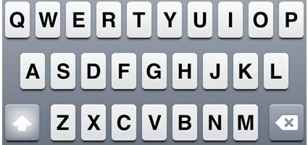
Simple substitution cipher
A generalization of the Caesar cipher, called a simple substitution cipher or monoalphabetic substitution cipher, maps plaintext letters to ciphertext letters according to a fixed mapping (the key).
A single cipher alphabet (mapping from plain alphabet to cipher alphabet ) is used per message.
Example:
p : ABCDEFGHIJKLMNOPQRSTUVWXYZ
F_{k}(p) : QWERTYUIOPASDFGHJKLZXCVBNM
Both the sender and receiver secretly share the key, representing the plaintext-ciphertext letter mapping, which is also called the substitution alphabet.

Slide 27
Cracking the simple substitution cipher
There are 26! = ~4 x 10²⁶ possible keys
Exhaustive key search is not practical
Simple substitution ciphers were considered strong for many centuries
In 850 CE, Arab/Iraqi scientist Abu Yusuf Yaqub ibn Ishaq al-Kindi published his book “Risalah fi Istikhraj al-Mu’amma” (A Manuscript on Deciphering Cryptographic Messages), which contains the first ever published description of how to crack simple substitution ciphers
The method he described is now known as frequency analysis.
Exploiting the regularities of the language.

Slide 28
Frequency analysis
The statistical distribution of letter frequencies of a message (text) written in any language tend towards a known letter frequency distribution profile of the language
This is particularly true for long messages (i.e., the longer the text, the closer the letter frequency distributions match the language’s letter frequency distributions)
The simple substitution cipher preserves the letter frequency distributions of the plaintext in the ciphertext (i.e., information about the plaintext is leaked in the ciphertext)
The attacker takes a frequency count of the ciphertext letters and tries to match them to the letter frequency distribution profile of the plaintext language

Slide 29
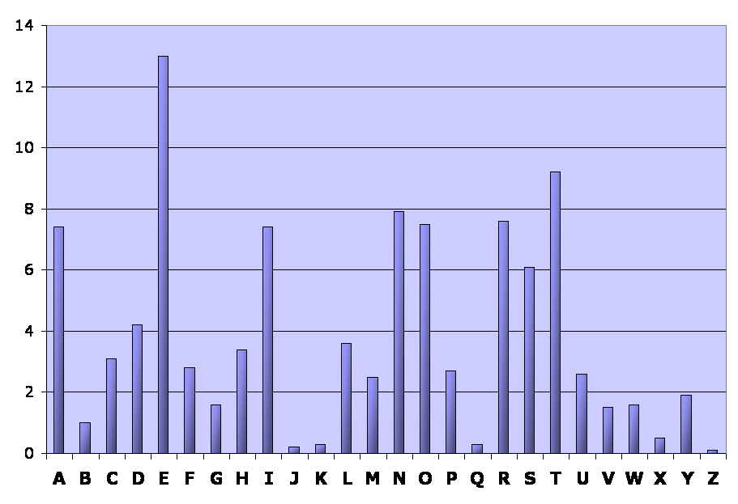
English language: Relative letter frequencies
Letter | A | B | C | D | E | F | G | H | I | J | K | L | M
Frequency | 7.4 | 1.0 | 3.1 | 4.2 | 13.0 | 2.8 | 1.6 | 3.4 | 7.4 | 0.2 | 0.3 | 3.6 | 2.5
Letter | N | O | P | Q | R | S | T | U | V | W | X | Y | Z
Frequency | 7.9 | 8.0 | 2.7 | 0.3 | 8.0 | 6.1 | 9.2 | 2.6 | 1.5 | 1.6 | 0.5 | 1.9 | 0.1

Slide 30
Example: Frequency analysis
Ciphertext:
R jrk hbxiu lk vai vzihova ohlls lo rk rmrsvjikv ywbhtbkn. Ixise jlskbkn ai vrgiu vai ihixrvls tlzk vl vai hlyye rkt hirxiu vai ywbhtbkn. Bk vai ixikbkn, ai nivu bkvl vai ihixrvls, rkt, bo vaisi bu uljilki ihui bk vai ihixrvls -- ls bo bv zru srbkbkn varv tre -- ai nliu yrpg vl abu ohlls tbsipvhe. Alzixis, bo vaisi bu klylte ihui bk vai ihixrvls rkt bv aruk'v srbkit, ai nliu vl vai vikva ohlls rkt zrhgu wm vzl ohbnavu lo uvrbsu vl abu sllj.
Letter frequency count (total = 344 letters):
Letter | A | B | C | D | E | F | G | H | I | J | K | L | M
Frequency | 23 | 26 | 0 | 0 | 5 | 0 | 3 | 18 | 49 | 5 | 26 | 32 | 2
Letter | N | O | P | Q | R | S | T | U | V | W | X | Y | Z
Frequency | 9 | 10 | 2 | 0 | 24 | 19 | 11 | 19 | 37 | 3 | 9 | 6 | 6

Slide 31
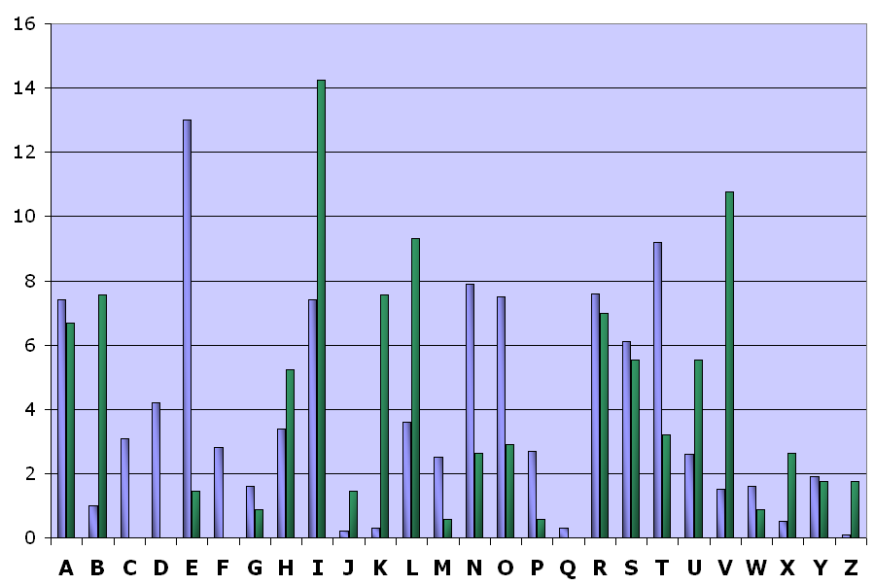
Relative frequency distributions (English & ciphertext)

Slide 32
Example: Frequency analysis
From the frequency distributions, we assume that:
The ciphertext letter I corresponds to the plaintext letter E (the most frequent letter in the English language)
The ciphertext letter V corresponds to the plaintext letter T (the second most frequent letter in the English language)
Partially decrypted ciphertext (red = plaintext):
R jrk hbxeu lk vae vzehova ohlls lo rk rmrsvjekv ywbhtbkn. Exese jlskbkn ae vrgeu vae ehexrvls tlzk vl vae hlyye rkt herxeu vae ywbhtbkn. Bk vae exekbkn, ae nevu bkvl vae ehexrvls, rkt, bo vaese bu uljelke ehue bk vae ehexrvls -- ls bo bv zru srbkbkn varv tre -- ae nleu yrpg vl abu ohlls tbsepvhe. Alzexes, bo vaese bu klylte ehue bk vae ehexrvls rkt bv aruk'v srbket, ae nleu vl vae vekva ohlls rkt zrhgu wm vzl ohbnavu lo uvrbsu vl abu sllj.

Slide 33
Example: Frequency analysis
From the frequency distributions, we assume that:
The ciphertext letter I corresponds to the plaintext letter E (the most frequent letter in the English language)
The ciphertext letter V corresponds to the plaintext letter T (the second most frequent letter in the English language)
Partially decrypted ciphertext (red = plaintext):
R jrk hbxeu lk tae tzehota ohlls lo rk rmrsvjekt ywbhtbkn. Exese jlskbkn ae trgeu tae ehexrtls tlzk tl tae hlyye rkt herxeu tae ywbhtbkn. Bk tae exekbkn, ae nevu bktl tae ehexrtls, rkt, bo taese bu uljelke ehue bk tae ehexrtls -- ls bo bt zru srbkbkn tart tre -- ae nleu yrpg tl abu ohlls tbsepthe. Alzexes, bo taese bu klylte ehue bk tae ehexrvls rkt bt aruk't srbket, ae nleu tl tae tekta ohlls rkt zrhgu wm tzl ohbnatu lo utrbsu tl abu sllj.

Slide 34
Example: Frequency analysis
We can assume that the ciphertext letter A corresponds to the plaintext letter H because:
The digram ‘TH’ is the most common in the English language
The word “THE” is the only frequently used 3-letter English word starting with T and ending with E
Partially decrypted ciphertext (red = plaintext):
R jrk hbxeu lk the tzehoth ohlls lo rk rmrsvjekt ywbhtbkn. Exese jlskbkn he trgeu the ehexrtls tlzk tl the hlyye rkt herxeu the ywbhtbkn. Bk the exekbkn, he nevu bktl the ehexrtls, rkt, bo these bu uljelke ehue bk the ehexrtls -- ls bo bt zru srbkbkn thrt tre -- he nleu yrpg tl hbu ohlls tbsepthe. Hlzexes, bo taese bu klylte ehue bk the ehexrtls rkt bt hruk't srbket, he nleu tl the tekth ohlls rkt zrhgu wm tzl ohbnatu lo utrbsu tl hbu sllj.

Slide 35
Example: Frequency analysis
We can assume that the ciphertext letter R corresponds to the plaintext letter A because:
The word “THAT” is the only frequently used 4-letter English word starting with ‘TH’ and ending with T
The relative frequency of R in the ciphertext closely approximates the relative frequency of A in English
Partially decrypted ciphertext (red = plaintext):
A jak hbxeu lk the tzehoth ohlls lo ak amasvjekt ywbhtbkn. Exese jlskbkn he tageu the ehexatls tlzk tl the hlyye akt heaxeu the ywbhtbkn. Bk the exekbkn, he nevu bktl the ehexatls, akt, bo these bu uljelke ehue bk the ehexatls -- ls bo bt zau sabkbkn that tae -- he nleu yapg tl hbu ohlls tbsepthe. Hlzexes, bo taese bu klylte ehue bk the ehexatls akt bt hauk't sabket, he nleu tl the tekth ohlls akt zahgu wm tzl ohbnatu lo utabsu tl hbu sllj.

Slide 36
Example: Frequency analysis
We can assume that the ciphertext letter K corresponds to the plaintext letter N because:
The words “AN” and “AT” are the only frequently used 2-letter English words starting with A
The relative frequency of K in the ciphertext closely approximates the relative frequency of N in English
Partially decrypted ciphertext (red = plaintext):
A jan hbxeu ln the tzehoth ohlls lo an amasvjent ywbhtbnn. Exese jlsnbnn he tageu the ehexatls tlzn tl the hlyye ant heaxeu the ywbhtbnn. Bn the exenbnn, he nevu bntl the ehexatls, ant, bo these bu uljelne ehue bn the ehexatls -- ls bo bt zau sabnbnn that tae -- he nleu yapg tl hbu ohlls tbsepthe. Hlzexes, bo taese bu nlylte ehue bn the ehexatls ant bt haun't sabnet, he nleu tl the tekth ohlls ant zahgu wm tzl ohbnatu lo utabsu tl hbu sllj.

Slide 37
Example: Frequency analysis
We assume that:
The ciphertext letter T corresponds to the plaintext letter D (from the word ‘ant’)
The ciphertext letter B corresponds to the plaintext letter I (from the words ‘bt’ and ‘bn’)
Partially decrypted ciphertext (red = plaintext):
A jan hixeu ln the tzehoth ohlls lo an amasijent ywihtinn. Exese jlsninn he tageu the ehexatls dlzn tl the hlyye and heaxeu the ywihdinn. In the exeninn, he nevu intl the ehexatls, and, io these iu uljelne ehue in the ehexatls -- ls io it zau saininn that dae -- he nleu yapg tl hbu ohlls tisepthe. Hlzexes, io taese iu nlylte ehue in the ehexatls ant it haun't sainet, he nleu tl the tekth ohlls and zahgu wm tzl ohinatu lo utaisu tl hiu sllj.
Notes:
A man lives on the twelfth floor of an apartment building. Every morning he takes the elevator down to the lobby and leaves the building. In the evening, he gets into the elevator, and, if there is someone else in the elevator -- or if it was raining that day -- he goes back to his floor directly. However, if there is nobody else in the elevator and it hasn't rained, he goes to the tenth floor and walks up two flights of stairs to his room.

Slide 38
Example: Frequency analysis
If you continue like this, completing words (using your knowledge of the English language) and matching ciphertext letters with probable plaintext letters (using the relative frequencies), you will eventually obtain a complete decryption of the message and will also have recovered the key (the substitution alphabet)
The substitution alphabet for this example is:
p : ABCDEFGHIJKLMNOPQRSTUVWXYZ
F_{k}(p) : RYPTIONABFGHJKLMQSUVWXZDEC
Notes:
Monoalphabetic Substitution Cipher - Online Cryptogram Decoder, Solver (dcode.fr)

Slide 39
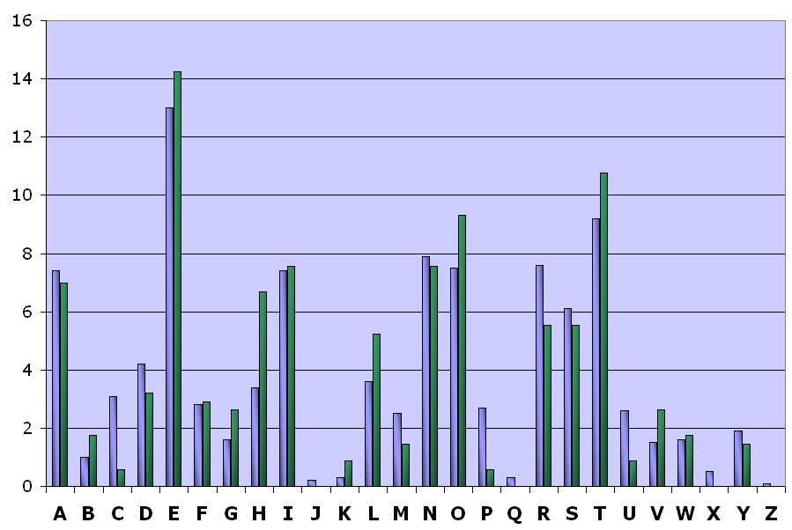
Relative frequency distributions (English & plaintext)

Slide 40
Other English language features
Digram frequencies
Common digraphs: EN, RE, ER, NT, TH
Trigram frequencies
Common trigrams: THE, ING, THA, ENT
Vowels other than E are rarely followed by another vowel
The letter Q is followed only by U

Slide 41
End of Lecture

Slide 42
Any Questions ?

